Slide 1
Normal Distribution and Parameter Estimation
Sections 6.1-6.3, 7.1-7.2
Statistics for Managers Using Microsoft Excel® 7e Copyright ©2014 Pearson Education, Inc.
Chap 6-<number>

Slide 2
Learning Objectives
In this chapter, you learn:
How continuous distributions are different from discrete distributions.
How to compute probabilities from the normal distribution
How to use the normal distribution to solve business problems
Statistics for Managers Using Microsoft Excel® 7e Copyright ©2014 Pearson Education, Inc.
Chap 6-<number>

Slide 3
Continuous Probability Distributions
A continuous random variable is a variable that can assume any value on an interval
  thickness of an item, weight, length
  time required to complete a task
  temperature
  height, in inches
  miles per gallon
Statistics for Managers Using Microsoft Excel® 7e Copyright ©2014 Pearson Education, Inc.
Chap 6-<number>

Slide 4
Probability Density
A function f(x) ≥ 0 that shows the more likely and less likely intervals of variable X.
P(a ≤ X ≤ b) = area under f(x) from a to b
f(X)
P
(
a
≤
X
≤
b
)
=
P
(
a
<
X
<
b
)
(Note that the probability of any individual value is zero)
a
b
X
Chap 5-<number>

Slide 5
Probability is the area under the density curve
f(X)
P
(
a
≤
X
≤
b
)
=
P
(
a
<
X
<
b
)
(Note that the probability of any individual value is zero)
a
b
X
Statistics for Managers Using Microsoft Excel® 7e Copyright ©2014 Pearson Education, Inc.
Statistics for Managers Using Microsoft Excel® 7e Copyright ©2014 Pearson Education, Inc.
Chap 5-<number>
Chap 6-<number>

Slide 6
The Normal Distribution
‘Bell Shaped’
Symmetrical
Mean, Median and Mode
are Equal
Location is determined by the mean, μ
Spread is determined by the standard deviation, σ
The random variable has an infinite theoretical range:
+ ∞ to − ∞
f(X)
σ
X
μ
Mean
= Median
= Mode
Statistics for Managers Using Microsoft Excel® 7e Copyright ©2014 Pearson Education, Inc.
Chap 6-<number>

Slide 7
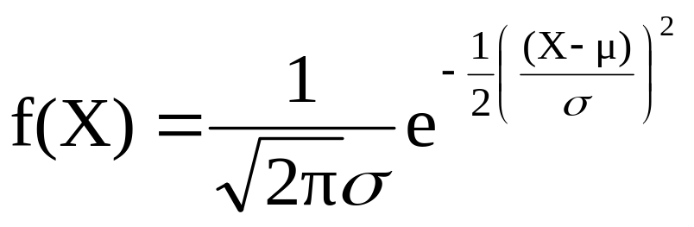
The Normal Distribution
Density Function
The formula for the normal probability density function is
Where e = the mathematical constant approximated by 2.71828
π = the mathematical constant approximated by 3.14159
μ = the population mean
σ = the population standard deviation
X = any value of the continuous variable
Statistics for Managers Using Microsoft Excel® 7e Copyright ©2014 Pearson Education, Inc.
Chap 6-<number>

Slide 8
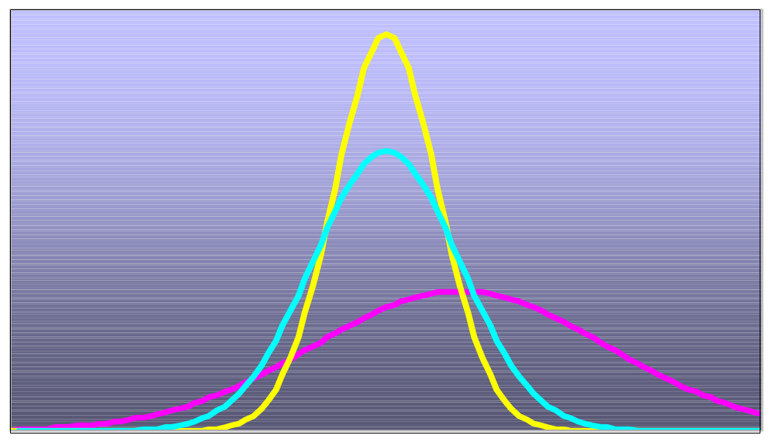
Many Normal Distributions
By varying the parameters μ and σ, we obtain different normal distributions
Statistics for Managers Using Microsoft Excel® 7e Copyright ©2014 Pearson Education, Inc.
Chap 6-<number>

Slide 9
The Normal Distribution Shape
f(X)
Changing μ shifts the distribution left or right.
Changing σ increases or decreases the spread.
σ
μ
X
Statistics for Managers Using Microsoft Excel® 7e Copyright ©2014 Pearson Education, Inc.
Chap 6-<number>

Slide 10
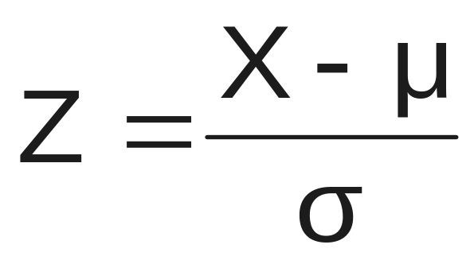
The Standardized Normal
Any normal distribution (with any mean μ and standard deviation σ) can be transformed into the standardized normal distribution (Z)
The standardized normal distribution (Z) has a mean of 0 and a standard deviation of 1
Statistics for Managers Using Microsoft Excel® 7e Copyright ©2014 Pearson Education, Inc.
Chap 6-<number>

Slide 11
The Standardized
Normal Distribution
Also known as the “Z” distribution
Mean is 0
Standard Deviation is 1
f(Z)
1
Z
0
Values above the mean have positive Z-values, values below the mean have negative Z-values
Statistics for Managers Using Microsoft Excel® 7e Copyright ©2014 Pearson Education, Inc.
Chap 6-<number>

Slide 12


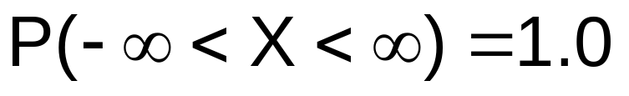
Probability as
Area Under the Curve
The total area under the curve is 1.0, and the curve is symmetric, so half is above the mean, half is below
f(X)
0.5
0.5
μ
X
Statistics for Managers Using Microsoft Excel® 7e Copyright ©2014 Pearson Education, Inc.
Chap 6-<number>

Slide 13
The Standardized Normal Table
The Cumulative Standardized Normal table in the textbook (Appendix table E.2) gives the probability less than a desired value of Z (i.e., from negative infinity to Z)
0.9772
Example:
P(Z < 2.00) = 0.9772
0
2.00
Z
Statistics for Managers Using Microsoft Excel® 7e Copyright ©2014 Pearson Education, Inc.
Chap 6-<number>

Slide 14
The Standardized Normal Table
(continued)
The column gives the value of Z to the second decimal point
Z 0.00 0.01 0.02 …
0.0
0.1
The row shows the value of Z to the first decimal point
.
.
.
The value within the table gives the probability from Z = − ∞ up to the desired Z value
2.0
.9772
P(Z < 2.00) = 0.9772
2.0
Statistics for Managers Using Microsoft Excel® 7e Copyright ©2014 Pearson Education, Inc.
Chap 6-<number>

Slide 15
General Procedure for Finding Normal Probabilities
To find P(a < X < b) when X is distributed normally:
Draw the normal curve for the problem in
terms of X
Standardize X by computing Z
Use the Standardized Normal Table for Z
Statistics for Managers Using Microsoft Excel® 7e Copyright ©2014 Pearson Education, Inc.
Chap 6-<number>

Slide 16
Example
Let X represent the time it takes (in seconds) to download an image file from the internet.
Suppose X is normal with a mean of 18.0 seconds and a standard deviation of 5.0 seconds. Find P(X < 18.6)
X
18.0
18.6
Statistics for Managers Using Microsoft Excel® 7e Copyright ©2014 Pearson Education, Inc.
Chap 6-<number>

Slide 17
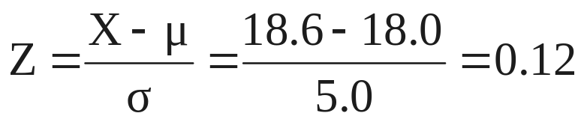
Finding Normal Probabilities
(continued)
Let X represent the time it takes, in seconds to download an image file from the internet.
Suppose X is normal with a mean of 18.0 seconds and a standard deviation of 5.0 seconds. Find P(X < 18.6)
μ = 18
σ = 5
μ = 0
σ = 1
18
18.6
X
0
0.12
Z
P(X < 18.6)
P(Z < 0.12)
Statistics for Managers Using Microsoft Excel® 7e Copyright ©2014 Pearson Education, Inc.
Chap 6-<number>

Slide 18
Solution: Finding P(Z < 0.12)
Standardized Normal Probability
Table (Portion)
P(X < 18.6)
= P(Z < 0.12)
Z
.00
.01
.02
0.5478
0.0
.5000
.5040
.5080
0.1
.5398
.5438
.5478
0.2
.5793
.5832
.5871
Z
0.3
.6179
.6217
.6255
0.00
0.12
Statistics for Managers Using Microsoft Excel® 7e Copyright ©2014 Pearson Education, Inc.
Chap 6-<number>

Slide 19
Finding Normal
Upper Tail Probabilities
Suppose X is normal with mean 18.0 and standard deviation 5.0.
Now Find P(X > 18.6)
X
18.0
18.6
Statistics for Managers Using Microsoft Excel® 7e Copyright ©2014 Pearson Education, Inc.
Chap 6-<number>

Slide 20
Finding Normal
Upper Tail Probabilities
(continued)
Now Find P(X > 18.6) by the complement rule…
P(X > 18.6) = P(Z > 0.12) = 1.0 - P(Z ≤ 0.12)
= 1.0 - 0.5478 = 0.4522
0.5478
1.000
1.0 - 0.5478 = 0.4522
Z
Z
0
0
0.12
0.12
Statistics for Managers Using Microsoft Excel® 7e Copyright ©2014 Pearson Education, Inc.
Chap 6-<number>

Slide 21
Probabilities in the Lower Tail
Suppose X is normal with mean 18.0 and standard deviation 5.0.
Find P(17.4 < X < 18)
X
18.0
17.4
Statistics for Managers Using Microsoft Excel® 7e Copyright ©2014 Pearson Education, Inc.
Chap 6-<number>

Slide 22
Probabilities in the Lower Tail
(continued)
Find P(17.4 < X < 18)…
P(17.4 < X < 18)
= P(-0.12 < Z < 0)
= P(Z < 0) – P(Z ≤ -0.12)
= 0.5000 - 0.4522 = 0.0478
0.0478
0.4522
The Normal distribution is symmetric, so this probability is the same as P(0 < Z < 0.12)
17.4
18.0
X
-0.12
0
Z
Statistics for Managers Using Microsoft Excel® 7e Copyright ©2014 Pearson Education, Inc.
Chap 6-<number>

Slide 23
“Empirical” Rules
What can we say about the distribution of values around the mean? For any normal distribution:
f(X)
μ ± 1σ encloses about 68.26% of X’s
σ
σ
X
μ-1σ
μ
μ+1σ
68.26%
Statistics for Managers Using Microsoft Excel® 7e Copyright ©2014 Pearson Education, Inc.
Chap 6-<number>

Slide 24
The Empirical Rule
(continued)
μ ± 2σ covers about 95% of X’s
μ ± 3σ covers about 99.7% of X’s
2σ
2σ
3σ
3σ
μ
x
μ
x
95.44%
99.73%
Statistics for Managers Using Microsoft Excel® 7e Copyright ©2014 Pearson Education, Inc.
Chap 6-<number>

Slide 25
Example
Page 203, #6.7(a,b,c)
#6.7d… Inverse problem… We know the probability, but we need the value of X
Statistics for Managers Using Microsoft Excel® 7e Copyright ©2014 Pearson Education, Inc.
Chap 5-<number>

Slide 26
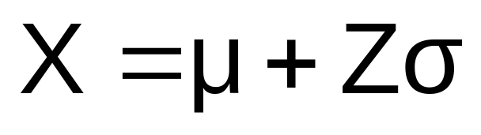
Given a Normal Probability
Find the X Value
Steps to find the X value for a known probability:
1. Find the Z value for the known probability
2. Convert to X units using the formula:
Statistics for Managers Using Microsoft Excel® 7e Copyright ©2014 Pearson Education, Inc.
Chap 6-<number>

Slide 27
Finding the X value for a Known Probability
(continued)
Example:
Let X represent the time it takes (in seconds) to download an image file from the internet.
Suppose X is normal with mean 18.0 and standard deviation 5.0
Find X such that 20% of download times are less than X.
0.2000
?
18.0
X
?
0
Z
Statistics for Managers Using Microsoft Excel® 7e Copyright ©2014 Pearson Education, Inc.
Chap 6-<number>

Slide 28
Find the Z value for
20% in the Lower Tail
1. Find the Z value for the known probability
Standardized Normal Probability
Table (Portion)
20% area in the lower tail is consistent with a Z value of -0.84
Z
…
.03
.04
.05
-0.9
…
.1762
.1736
.1711
0.2000
-0.8
…
.2033
.2005
.1977
-0.7
…
.2327
.2296
.2266
?
18.0
X
-0.84
0
Z
Statistics for Managers Using Microsoft Excel® 7e Copyright ©2014 Pearson Education, Inc.
Chap 6-<number>

Slide 29
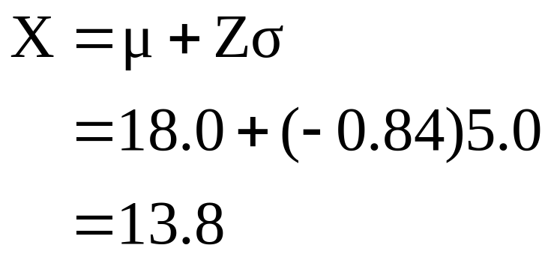
Finding the X value
2. Convert to X units using the formula:
So 20% of the values from a distribution with mean 18.0 and standard deviation 5.0 are less than 13.80
Statistics for Managers Using Microsoft Excel® 7e Copyright ©2014 Pearson Education, Inc.
Chap 6-<number>

Slide 30
Example
Now we can do #6.7d on p.203
Statistics for Managers Using Microsoft Excel® 7e Copyright ©2014 Pearson Education, Inc.
Chap 5-<number>

Slide 31
Example
The average household income in some country is 900 coins, and the standard deviation is 200 coins. Assuming the Normal distribution of incomes,
(a) Compute the proportion of “the middle class,” whose income is between 600 and 1200 coins.
(b) The government decides to issue food stamps to the poorest 3% of households. Below what income will families receive food stamps?
Statistics for Managers Using Microsoft Excel® 7e Copyright ©2014 Pearson Education, Inc.
Chap 5-<number>

Slide 32
Excel commands
Normal probability
=NORM.DIST(x,mean,standard_dev,cumulative)
Normal inverse problem, value of X
=NORM.INV(probability,mean,standard_dev)
Cumulative=1 asks for a probability P(X ≤ x).
Cumulative=0 asks for a density f(x).

Slide 33
Chapter 7 (7.1-7.2)
Parameter Estimation
and Sampling Distributions
Chap 7-<number>

Slide 34
Learning Objectives
In this chapter, you learn:
Estimation of means, variances, proportions
The concept of a sampling distribution
To compute probabilities about the sample mean and the sample proportion
How to use the Central Limit Theorem
Chap 7-<number>

Slide 35
Sampling Distributions
A sampling distribution is a distribution of a statistic computed from a sample of size n.
A sample is random, collected from a population. Hence, all statistics computed from it are random variables.
Chap 7-<number>

Slide 36



Example
Assume there is a population …
Population size N=4
Random variable, X,
is age of individuals
Values of X: 18, 20,
22, 24 (years)
D
A
B
C
Chap 7-<number>

Slide 37
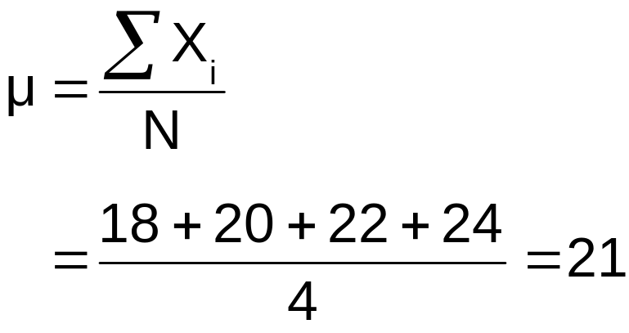
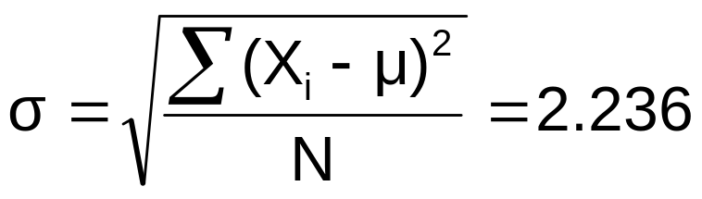
Example
(continued)
Population parameters:
P(x)
.3
.2
.1
0
18 20 22 24
A B C D
x
Chap 7-<number>

Slide 38
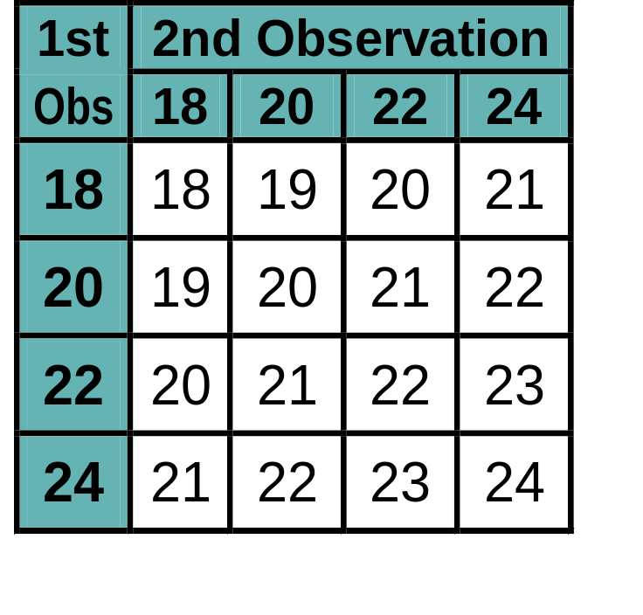
Now consider all possible samples of size n=2
Example
(continued)
16 Sample Means
1st Obs | 2nd Observation
 | 18 | 20 | 22 | 24
18 | 18,18 | 18,20 | 18,22 | 18,24
20 | 20,18 | 20,20 | 20,22 | 20,24
22 | 22,18 | 22,20 | 22,22 | 22,24
24 | 24,18 | 24,20 | 24,22 | 24,24
16 possible samples (sampling with replacement)
Chap 7-<number>

Slide 39

Sampling Distribution of All Sample Means
Example
(continued)
16 Sample Means
Sample Means Distribution
_
P(X)
.3
.2
.1
0
_
18 19 20 21 22 23 24
X
Chap 7-<number>

Slide 40
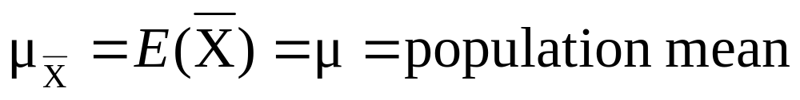
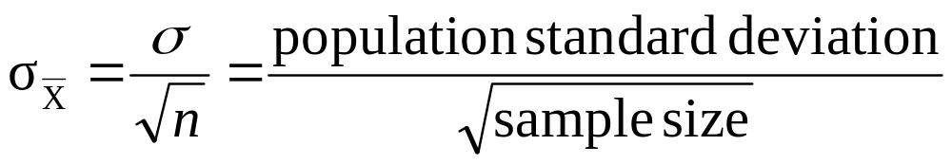
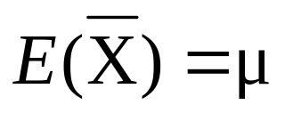
Sample mean has the following mean and standard deviation:
Sampling Distribution of the Sample Mean
Sample mean is unbiased because
Its standard deviation is also called the standard error of the sample mean. It decreases as the sample size increases.
Chap 7-<number>

Slide 41

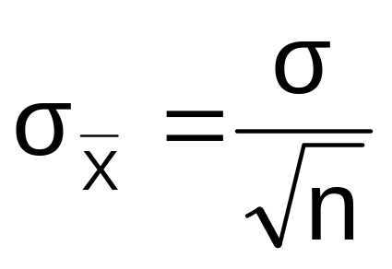
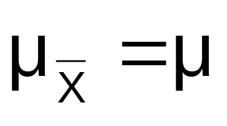
Sample Mean for a Normal Population
If a population is normal with mean μ and standard deviation σ, the sampling distribution of is also normal with
and
Chap 7-<number>

Slide 42
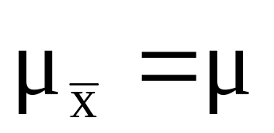


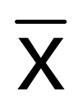

Sampling Distribution Properties
Normal Population Distribution
(i.e. is unbiased )
Normal Sampling Distribution
(has the same mean)
Chap 7-<number>

Slide 43
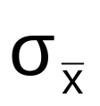

Sampling Distribution Properties
(continued)
  As n increases,
  decreases
Larger sample size
Smaller sample size
Chap 7-<number>

Slide 44
Sample Mean for non-Normal Populations
Central Limit Theorem:
  Even if the population is not normal,
  …sample means are approximately normal as long as the sample size is large enough.
Chap 7-<number>

Slide 45
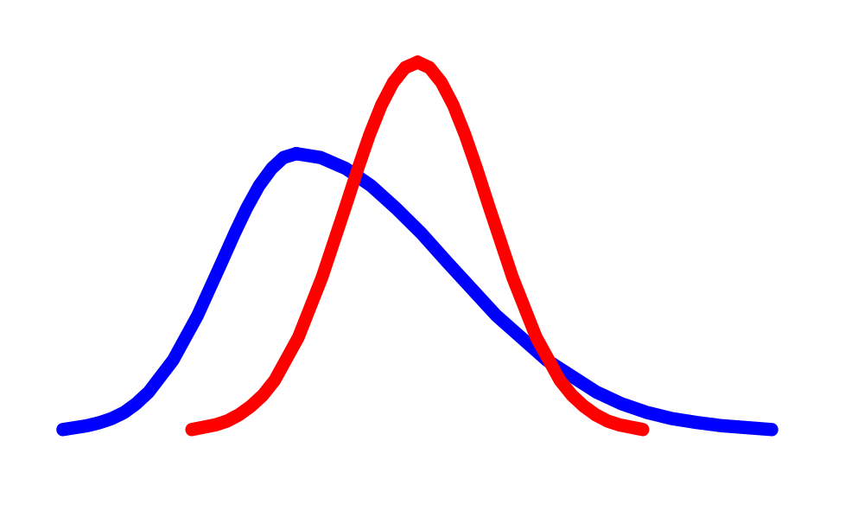
Central Limit Theorem
the sampling distribution of the sample mean becomes almost normal regardless of shape of population
As the sample size gets large enough…
n↑
Chap 7-<number>

Slide 46
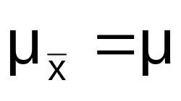

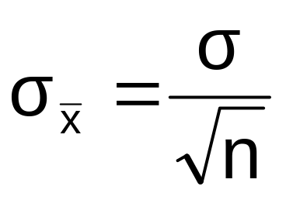

Sample Mean if the Population is not Normal
(continued)
Population Distribution
Sampling distribution properties:
Central Tendency
Variation
Sampling Distribution
(becomes normal as n increases)
Larger sample size
Smaller sample size
Chap 7-<number>

Slide 47
How Large is Large Enough?
For most distributions, n > 30 will give a sampling distribution that is nearly normal
For fairly symmetric distributions, n > 15
For normal population distributions, the sampling distribution of the mean is always normally distributed
Chap 7-<number>

Slide 48

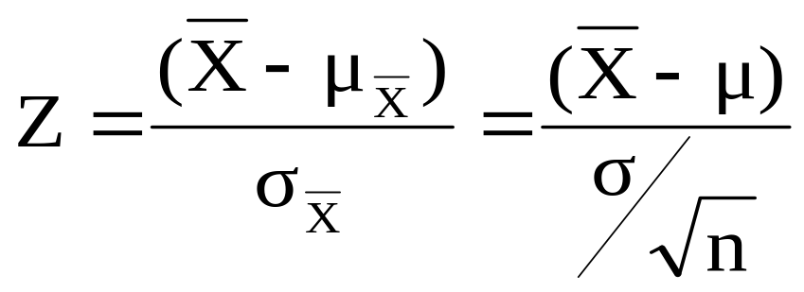



Z-value for Sampling Distribution of the Mean
Z-value for the sampling distribution of :
where: = sample mean
= population mean
= population standard deviation
n = sample size
Chap 7-<number>
Statistics for Managers Using Microsoft Excel® 7e Copyright ©2014 Pearson Education, Inc.

Slide 49
Example
Suppose a population has mean μ = 8 and standard deviation σ = 3. Suppose a random sample of size n = 36 is selected.
What is the probability that the sample mean is between 7.8 and 8.2?
Chap 7-<number>

Slide 50


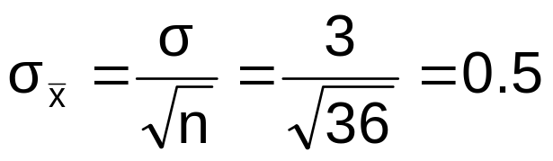
Example
(continued)
Solution:
Even if the population is not normally distributed, the central limit theorem can be used (n > 30)
… so the sampling distribution of is approximately normal
… with mean = 8
…and standard deviation
Chap 7-<number>

Slide 51
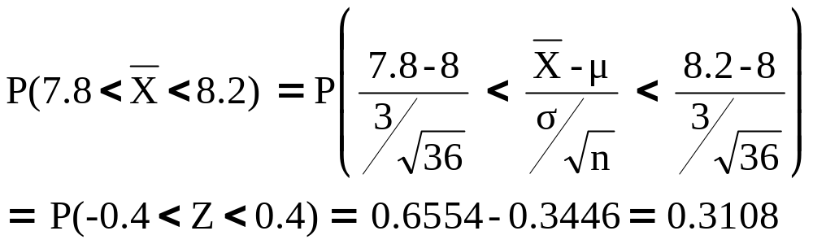




Example
(continued)
Solution (continued):
Population Distribution
Sampling Distribution
Standard Normal Distribution
?
?
?
?
?
?
?
?
?
?
Sample
Standardize
?
?
7.8 8.2
-0.4 0.4
Z
X
Chap 7-<number>

Slide 52
Examples
# 7.28, page 264
# 7.26, page 264
Chap 7-<number>

Slide 53
Chapter Summary
In this chapter we discussed
Continuous random variables
Normal distribution
Sampling distributions
The sampling distribution of the mean
  For normal populations
  Using the Central Limit Theorem
Calculating probabilities using sampling distributions
Chap 7-<number>

